Slide 1
Even More Data Modeling

Slide 2
Lesson Objectives
After completing this lesson you will be able to:
Understand one-to-one relationships
Understand how to model and query with subtypes
Know how to model and query with time

Slide 3
One-to-One Relationships
If one record in one table relates to at most one record in another table, it is a one-to-one relationship.
One-to-one relationships can be used to avoid the existence of Null columns.
Customer
ID
First_Name
Last_Name
Customer_Details
ID
Height
Weight
Birth_Date
Notes:
In the early days of database theory, it was believed that NULLABLE columns should be avoided. In more modern thinking, nullable columns are not so bad.

Slide 4
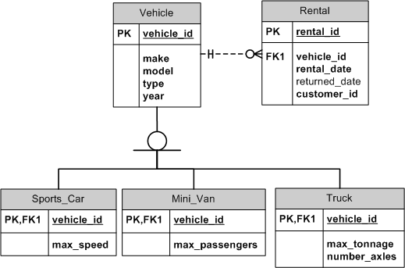
Subtypes – Multiple One-to-One Relations
Sometimes entities break down into different types with different attributes
The vehicle_id in the rental table could be for a sports car, mini van (people carrier) or a truck (lorry)
Notes:
Sometimes entities break down into different types with different attributes
The Vehicle table has a one-to-one relationship with the sports_car, mini_van and truck tables.

Slide 5
Queries With Subtypes
Example1: Find rentals for sports cars that can drive over 200 km/h
SELECT r.rental_id, sc.max_speed FROM rental r JOIN sports_car sc ON sc.vehicle_id = r.vehicle_id WHERE sc.max_speed > 200;
Rental table can join to the vehicle table or directly to the sports_car, mini_van, or truck tables

Slide 6
Modeling Time
Start
End
Stock_Price
Stock_id PK
Stock_ex_id PK
Start_date PK
End_date
Price
Price effective period
time
When values can change over time, the data can be modeled with a start and end date.
A null end date means that the record does not expire.

Slide 7
Queries With Time
Refer to Module16b_StockPrices.sql for examples.

Slide 8
Lesson Objectives
Having completed this lesson, you should now:
Understand one-to-one relations
Understand how to model and query with subtypes
Know how to model and query with time

